Slide 1

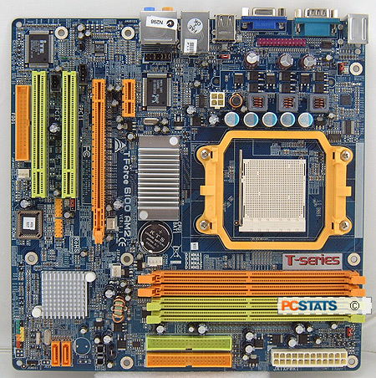


GPU Port
WIFI processor port
PCI-E
Sound processor port
CPU and Fan
R.A.M Memory
SATA Ports
IDE Ports

